Slide 1
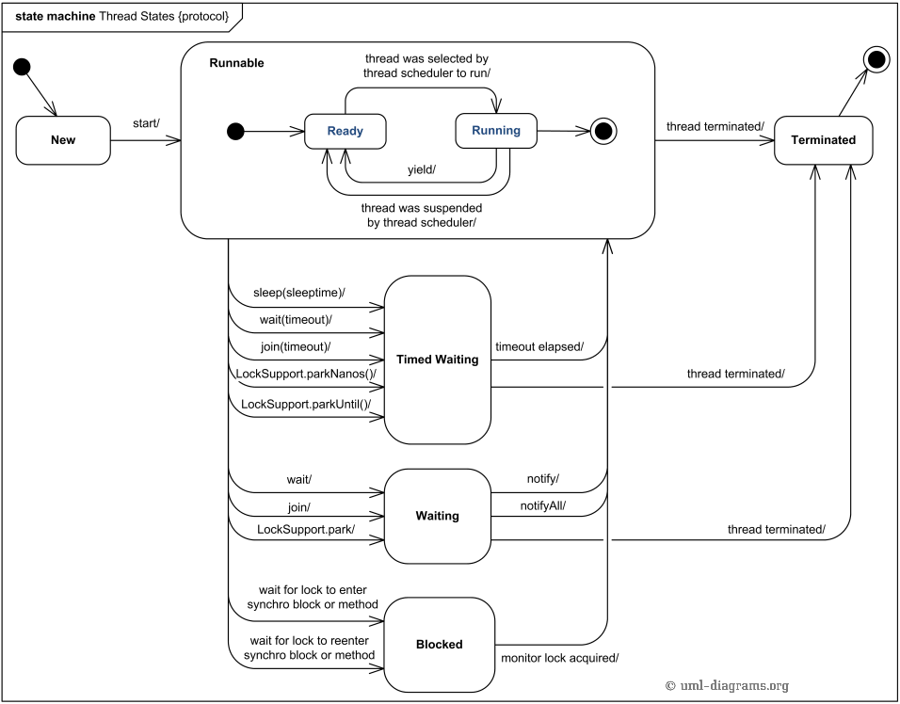

Slide 2

Producer and Consumer Problem in Java
Java Instructor Committee
Concurrent Programming Team
Xiaoyu Qu
exiaoqu
BID CBC Compass
2018-06-22

Slide 3
AGENDA
Producer-consumer problem
Java Cross-thread Solutions
Java Cross-process(JVM) Solutions
Java Cross-host Solutions
More advanced topics

Slide 4
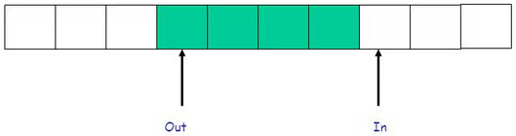
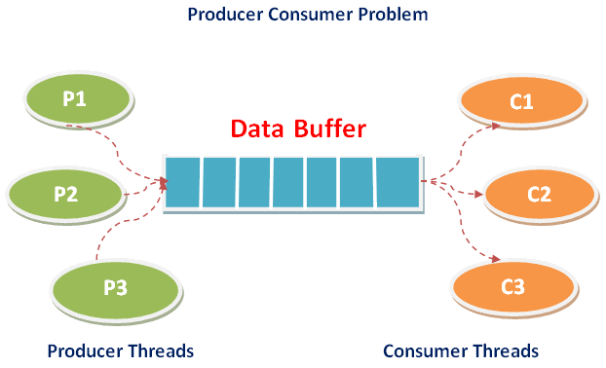
Producer-consumer problem
Also called the bounded-buffer problem
bounded-buffer : size N
Buffer is circular
One classic, concurrent multi-thread synchronization problem
Producers write data to buffer
Consumers read data from buffer
Shared buffer holds the produced data which is not yet consumed
Notes:
bounded-buffer: 有界缓冲区

Slide 5
Java Cross-thread Solutions
Wait and Notify
Lock and Condition
BlockingQueue
PipedInputStream and PipedOutStream

Slide 6
Wait and Notify
Facilities
Synchronized and Synchronized(Object)
Non-fair # Fair
Reentrant # Non-reentrant
Exclusive # Share Lock
Mutex # ReadWriteLock
Pessimistic # Optimistic
wait()/wait(timeout)/wait(timeout, nanos)
notify()/notifyAll()
Notes:
基础设施:
Synchronized关键字和Synchronized(Object)语句
Non-fair(非公平) schedule only # Fair(公平) schedule
Reentrant (锁定区可重入) # Non-reentrant不可重入
Exclusive (排它锁) # Share Lock(共享锁)
Mutex (互斥锁） # ReadWriteLock(读写锁)
Pessimistic(悲观锁) # Optimistic(乐观锁)
Object的wait()/ wait(timeout)方法
Object的notify()/notifyAll()方法
公平锁： Threads acquire a fair lock in the order in which they requested it 非公平锁： A non-fair lock permits barging: threads requesting a lock can jump ahead of the queue of waiting threads if the lock happens to be available when it is requested.
锁定区可重入: 线程可以进入任何一个它已经拥有的锁所同步着的代码块。
共享锁：该锁可被多个线程共有，典型的就是ReentrantReadWriteLock里的读锁。读锁是共享锁，写锁是排它锁。
悲观锁：总是假设最坏的情况，每次去拿数据的时候都认为别人会修改，所以每次在拿数据的时候都会上锁，这样别人想拿这个数据就会阻塞直到它拿到锁。
乐观锁：顾名思义，就是很乐观，每次去拿数据的时候都认为别人不会修改，所以不会上锁，但是在更新的时候会判断一下在此期间别人有没有去更新这个数据，可以使用版本号等机制。

Slide 7
Wait and Notify
Solution Description
Producer and consumer compete on Object's monitor lock
Notes:
原理
生产者和消费者线程对Object对象的monitor线程互斥锁的锁定竞争
Synchronized 锁定
wait 释放锁定->等待被Notify(或超时)->竞争并重新获得锁定
notify 唤醒处于锁等待状态的线程(Non-fair)
退出作用域释放锁
Demo
Synchronized内部的锁升级过程:
Biased Lock -> Lightweight Lock -> Heavyweight lock(偏向锁/轻量级锁/重量级锁)

Slide 8
Wait and Notify
Demo
Notes:
原理
生产者和消费者线程对Object对象的monitor线程互斥锁的锁定竞争
Synchronized 锁定
wait 释放锁定->等待被Notify(或超时)->竞争并重新获得锁定
notify 唤醒处于锁等待状态的线程(Non-fair)
退出作用域释放锁
Demo
Synchronized内部的锁升级过程:
Biased Lock -> Lightweight Lock -> Heavyweight lock(偏向锁/轻量级锁/重量级锁)

Slide 9
Enter Synchronized Block
1) - hold the lock, enter monitor block directly
2) – enter Blocked on the lock, non- interruptible
1)
2)

Slide 10
Wait()
1) - exit from monitor block
2) - enter Waiting
3) – exist from Waiting when being interrupted
wait(timeout)
wait(timeout, nanos)
1) - exit from monitor block
2) - enter Timed Waiting
3) – exist from Timed Waiting when timeout or being interrupted
2)
2)

Slide 11
Notify()
1) - one selected thread exit from Timed-Waiting
2) - one selected thread exit from Waiting
3) - hold the lock, enter monitor block directly
4) - enter Blocked on the lock, non-interruptible
1)
NotifyAll()
1) – all threads exit from Timed-Waiting
2) - all threads exit from Waiting
3) – one of threads hold the lock, enter monitor block directly, remains go 4)
4) – all enter Blocked, non-interruptible
2)
3)
4)

Slide 12
Exit Synchronized Block
1) – release lock
1)

Slide 13
Lock and Condition
Facilities
Lock
ReentrantLock(fair)
Non-fair or Fair
Reentrant # Non-reentrant
Exclusive # Share Lock
Mutex # ReadWriteLock
Pessimistic # Optimistic
Lock()/tryLock()/tryLock(timeout)/lockInterruptibly()
Conditions
Create from the lock object and only work with it
await()/several await()s with timeout/awaitUninterruptibly()
signal()/signalAll()
Notes:
基础设施
Lock
ReentrantLock
Non-fair(非公平) 或 Fair(公平) schedule
Reentrant (锁定区可重入) # Non-reentrant不可重入
Exclusive (排它锁) # Share Lock(共享锁)
Mutex (互斥锁） # ReadWriteLock(读写锁)
Pessimistic(悲观锁) # Optimistic(乐观锁)
Lock()/tryLock()/tryLock(timeout)
Condition 从Lock对象中创建出任意数目，只能和该锁配合使用
await()/await(timeout)
signal()/signalAll()
ReentrantLock.lockInterruptibly允许在等待时由其它线程调用等待线程的Thread.interrupt方法来中断等待线程的等待而直接返回，这时不用获取锁，而会抛出一个InterruptedException。 ReentrantLock.lock方法不允许Thread.interrupt中断,即使检测到Thread.isInterrupted,一样会继续尝试获取锁，失败则继续休眠。只是在最后获取锁成功后再把当前线程置为interrupted状态,然后再中断线程。

Slide 14
Lock and Condition
Solution Description
Producer and consumer compete on the eentrant lock object
Precisely wake-up control with different conditions
Demo
Notes:
原理
生产者和消费者线程对Lock对象进行锁定竞争
Lock.lock() 锁定(或超时)
可使用Multiple Condition Objects实现精确唤醒控制
Condition.await() 释放锁定->等待被Signal(或超时)->竞争并重新获得锁定
Condition. signal() 唤醒处于锁等待状态的线程(Non-fair/Fair)
Demo

Slide 15
Lock and Condition
Demo
Notes:
原理
生产者和消费者线程对Lock对象进行锁定竞争
Lock.lock() 锁定(或超时)
可使用Multiple Condition Objects实现精确唤醒控制
Condition.await() 释放锁定->等待被Signal(或超时)->竞争并重新获得锁定
Condition. signal() 唤醒处于锁等待状态的线程(Non-fair/Fair)
Demo

Slide 16
Lock()
1) - hold the lock, enter lock block directly
2) – enter Waiting on the lock, un-interruptable
lockInterruptibly()
1) – same 1) in Lock()
2) – enter Waiting on the lock, interruptable
1)
tryLock()
- Always in Runnable
- either hold the lock, return true
- or return false
2)
1)
2)
trylock(timeout)
– hold the lock, return true
- or enter Timed Waiting, timeout return false, interruptable
Notes:
About Java park()/unpack():
https://bugs.openjdk.java.net/browse/JDK-6311057
On Linux, simply a pthread_mutex and pthread_cond pair. A "park" does a pthread_condwait on the condition variable and an "unpark" does a pthread_condsignal.

Slide 17
await()
1) – release lock
2) - enter Waiting
3) – exist from Waiting when being interrupted
await(timeout), awaitNanos(), awaitUntil(date)
1) – release lock
2) – enter Timed Waiting
3) – exist from Waiting when timeout or being interrupted
awaitUninterruptibly()
1) – release lock
2) - enter Waiting, Uninterruptible
1)
2)

Slide 18
Signal()
1) – do unpack() to first condition wait thread, the thread enters Runnable and will compete the lock again.
2) – same as 1)
SignalAll()
1) – do unpack() to all condition wait threads, all threads enter Runnable, will compete the lock again.
2) – same as 1)
Note: Fair scheduling can’t be guaranted
1)
2)
Notes:
Java ReentrantLock support to Fair:
Even a fair ReentrantLock created, it doesn't guarantee that it's fair.

Slide 19
Unlock()
1) – release lock
1)

Slide 20
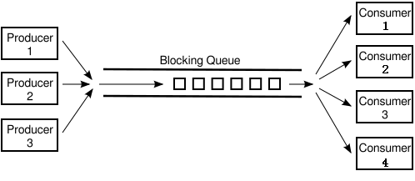
BlockingQueue
Facilites
BlockingQueue
LinkedBlockingDeque<>(capacity) used
Default capacity = Integer.MAX_VALUE
put() blocking write
take() blocking read
Solution Description
The blocking queue internally handles blocking and wakeup, which simplifies the design. Internal of it is a buffer that balances the processing power of producers and consumers.
Notes:
基础设施
BlockingQueue
LinkedBlockingDeque<>(capacity)
Default capacity = Integer.MAX_VALUE
put() 阻塞写入对象
take() 阻塞取出对象
原理
阻塞队列会处理阻塞和唤醒，这样简化了设计。其内部相当于一个缓冲区，可以平衡生产者和消费者的处理能力。

Slide 21
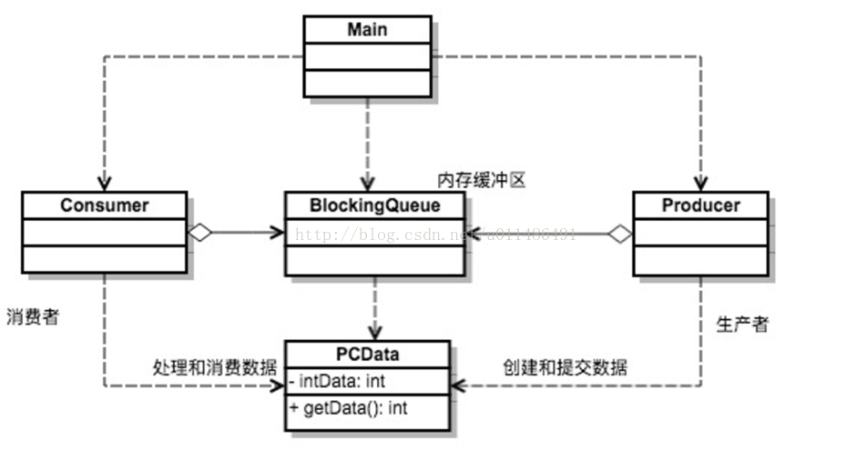
BlockingQueue
Java producer-consumer pattern

Slide 22
BlockingQueue
Demo
Lock & Condition internally used

Slide 23
PipedInputStream/PipedOutputStream
Facilities
PipedInputStream: receive byte stream
PipedOutputStream: send byte stream
Solution Description
Associate output stream with input stream
Use the internal buffer of PipedInputStream(Default 1024 bytes)
Use internal locks in PipedInputStream/PipedOutputStream
Based on byte stream, exists delimitation problem

Slide 24
PipedInputStream/PipedOutputStream
Demo
Synhcronized and wait()/notify() internally used.

Slide 25
Java Cross-process(JVM) Solutions
NIO and MappedByteBuffer(Java SHM solution)
Using Linux SystemV-IPC MQ through JNA

Slide 26
NIO and MappedByteBuffer
Facilites
NIO FileChannel
MappedByteBuffer
Using OS memory-mapped file mechanism(max 2G Bytes, Integer.MAX_VALUE)
Using direct byte buffer
Solution Description
Share memory-mapped file among processes
Mapped as direct byte buffer
Using the exclusive lock in FileChannel(File system lock)
Notes:
基础设施
NIO FileChannel(类似Unix-like OS上的文件描述符)
MappedByteBuffer
使用底层操作系统的Memory-mapped file机制
和Direct Byte Buffer
原理
跨JVM共享内存影射文件
使用直接内存Buffer做缓存区
使用FileChannel的排它锁

Slide 27
NIO and MappedByteBuffer
Demo

Slide 28
Using SystemV-IPC MQ through JNA
Facilites
System V IPC MQ(Linux System Call)
int msgget(key_t key, int msgflg)
int msgsnd(int msqid, const void *msgp, size_t msgsz, int msgflg)
size_t msgrcv(int msqid, void *msgp, size_t msgsz, long msgtyp, int msgflg)
JNA库
Origin from Sun， open source on top of JNI, using in Java side。
Solution Description
Using SystemV-IPC Message Queue in Unix/Linux OS
Data contained in each message buffer
Using internal mechanism in kernel, invisible to application
Notes:
基础设施
System V IPC / Linux System Call
int msgget(key_t key, int msgflg)
int msgsnd(int msqid, const void *msgp, size_t msgsz, int msgflg)
size_t msgrcv(int msqid, void *msgp, size_t msgsz, long msgtyp, int msgflg)
JNA库
源于Sun公司， 开源基于JNI的库，用于Java侧。
原理
使用操作系统的SystemV-IPC 消息队列
每个消息中的内存区
使用内核里的锁，对应用不可见
JNA(Java Native Access)是一个开源的Java框架，是Sun公司推出的一种调用本地方法的技术，是建立在经典的JNI基础之上的一个框架。之所以说它是JNI的替 代者，是因为JNA大大简化了调用本地方法的过程，使用很方便，基本上不需要脱离Java环境就可以完成。

Slide 29
Using SystemV-IPC MQ through JNA
Demo

Slide 30
Java Cross-host Solution
Broker-based distributed solution
DB-based distributed solution

Slide 31
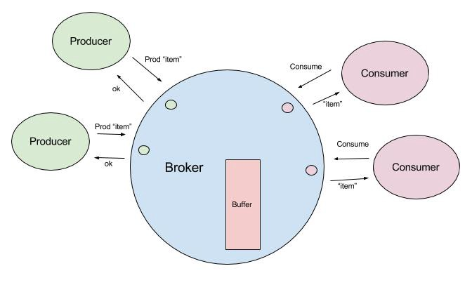
Java Cross-host Solution
Broker-based distributed solution
Netty NIO over Socket
NIO Selector and SocketChannel
Message Queues
Kafka Topics
Others, RabbitMQ, ZeroMQ, etc

Slide 32
Java Cross-host Solution
DB-based distributed solution
Redis
Mysql

Slide 33
生产者/消费者问题 更高级话题
数据安全
部署方式
不丢弃数据
分布式
并发模式
多进程
主动丢弃数据
多线程
可靠性
恢复
单线程
死锁
双缓冲区
低
队列缓冲区
环形数组
单个生产者
单个消费者
环形链表
IPC
MQ
Broker
耦合类型
锁(临界区)竞争
DB
多个生产者
单个消费者
高
消费者负载均衡
单个生产者
多个消费者
性能
多个生产者
多个消费者
生产者消费者模式
Notes:
并发模式：
- Actor模型 Erlang, Scala, Java Akka
- CSP(Communicating Sequential Process)模型： golang

Slide 34
Reference
Producer-consumer problem
Java实现跨线程生产者消费者Solutions
https://blog.csdn.net/u010983881/article/details/78554671
Java并发编程：Synchronized及其实现原理
http://www.cnblogs.com/paddix/p/5367116.html
Java并发编程：Synchronized底层优化（偏向锁、轻量级锁, 重量级锁）
https://www.cnblogs.com/paddix/p/5405678.html
BlockingQueu介绍：
http://wsmajunfeng.iteye.com/blog/1629354

Slide 35
Reference
基于阻塞队列的Java生产者消费者模式:
https://blog.csdn.net/u011486491/article/details/77849326
NIO and MappedByteBuffer
https://blog.csdn.net/huzhigenlaohu/article/details/52488947
https://blog.csdn.net/cloudeagle_bupt/article/details/52136085
Using IPC with JNA
https://www.cnblogs.com/lanxuezaipiao/p/3635556.html
分布式实现:
https://medium.com/@bizzard4/producer-consumer-the-whole-story-e0b4034406f1

Slide 36
Reference
生产消费者模式之深入理解(高级话题)
https://blog.csdn.net/sanyuesan0000/article/details/52996586

